Slide 1


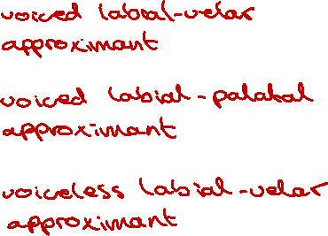

Double Articulations
The following are examples double articulations which include bilabial articulations.
Listen, Identify and describe each of them.
Click / use the forward key to see the answers.
sound | description | symbol
created by Antoin Rodgers under Creative Commons Attribution-ShareAlike 4.0 License - rodgeran@tcd.ie - @phonetic_antoin

Slide 2
Secondary Articulations / Places of Articulation
Each word or phrase is realised differently.
Describe the differences in realisation and transcribe each word using appropriate symbols and diacritics.
Click on the box to reveal the suggested answer. (All answers on the next slide.)
Audio | Word | Comments / Transcription
1. | <real> | [ɹiɫ] vs [ɹil] – dark vs light L; i.e., velarised vs non-velarised lateral approximant
2. | <Anna> | [ana] vs [an̪a] – voiced alveolar vs dental nasal (ignoring durational differences)
3. | <then> | [d̪ɛn] vs [ðɛn] – voiced dental plosive vs voiced alveolar fricative
4. | <take> | [tʰeɪkʰ]– aspirated voiceless velar plosive; [tʰeɪk^{x}] or [tʰeɪk͜x] — affricated voiceless velar plosive; [tʰeɪx] — voiceless velar fricative
5. | <tie> | [p͜tʰaɪ][t̪ʰaɪ] – doubly articulated voiceless alveolar plosive; voiceless dental plosive
6. | <to be or not to be> | 1st → [t̼] (voiceless labiolingual plosives) 2nd → [t] (voiceless alveolar plosives)
created by Antoin Rodgers under Creative Commons Attribution-ShareAlike 4.0 License - rodgeran@tcd.ie - @phonetic_antoin

Slide 3
Secondary Articulations / Places of Articulation
Each word or phrase is realised differently.
Describe the differences in realisation and transcribe each word using appropriate symbols and diacritics.
Click on the box to reveal the suggested answer. (All answers on the next slide.)
Audio | Word | Comments / Transcription
1. | <real> | [ɹiɫ] vs [ɹil] – dark vs light L; i.e., velarised vs non-velarised lateral approximant
2. | <Anna> | [ana] vs [an̪a] – voiced alveolar vs dental nasal (ignoring durational differences)
3. | <then> | [d̪ɛn] vs [ðɛn] – voiced dental plosive vs voiced alveolar fricative
4. | <take> | [tʰeɪkʰ]– aspirated voiceless velar plosive; [tʰeɪk^{x}] or [tʰeɪk͜x] — affricated voiceless velar plosive; [tʰeɪx] — voiceless velar fricative
5. | <tie> | [p͜tʰaɪ][t̪ʰaɪ] – doubly articulated voiceless alveolar plosive; voiceless dental plosive
6. | <to be or not to be> | 1st → [t̼] (voiceless labiolingual plosives) 2nd → [t] (voiceless alveolar plosives)
created by Antoin Rodgers under Creative Commons Attribution-ShareAlike 4.0 License - rodgeran@tcd.ie - @phonetic_antoin

